Slide 2
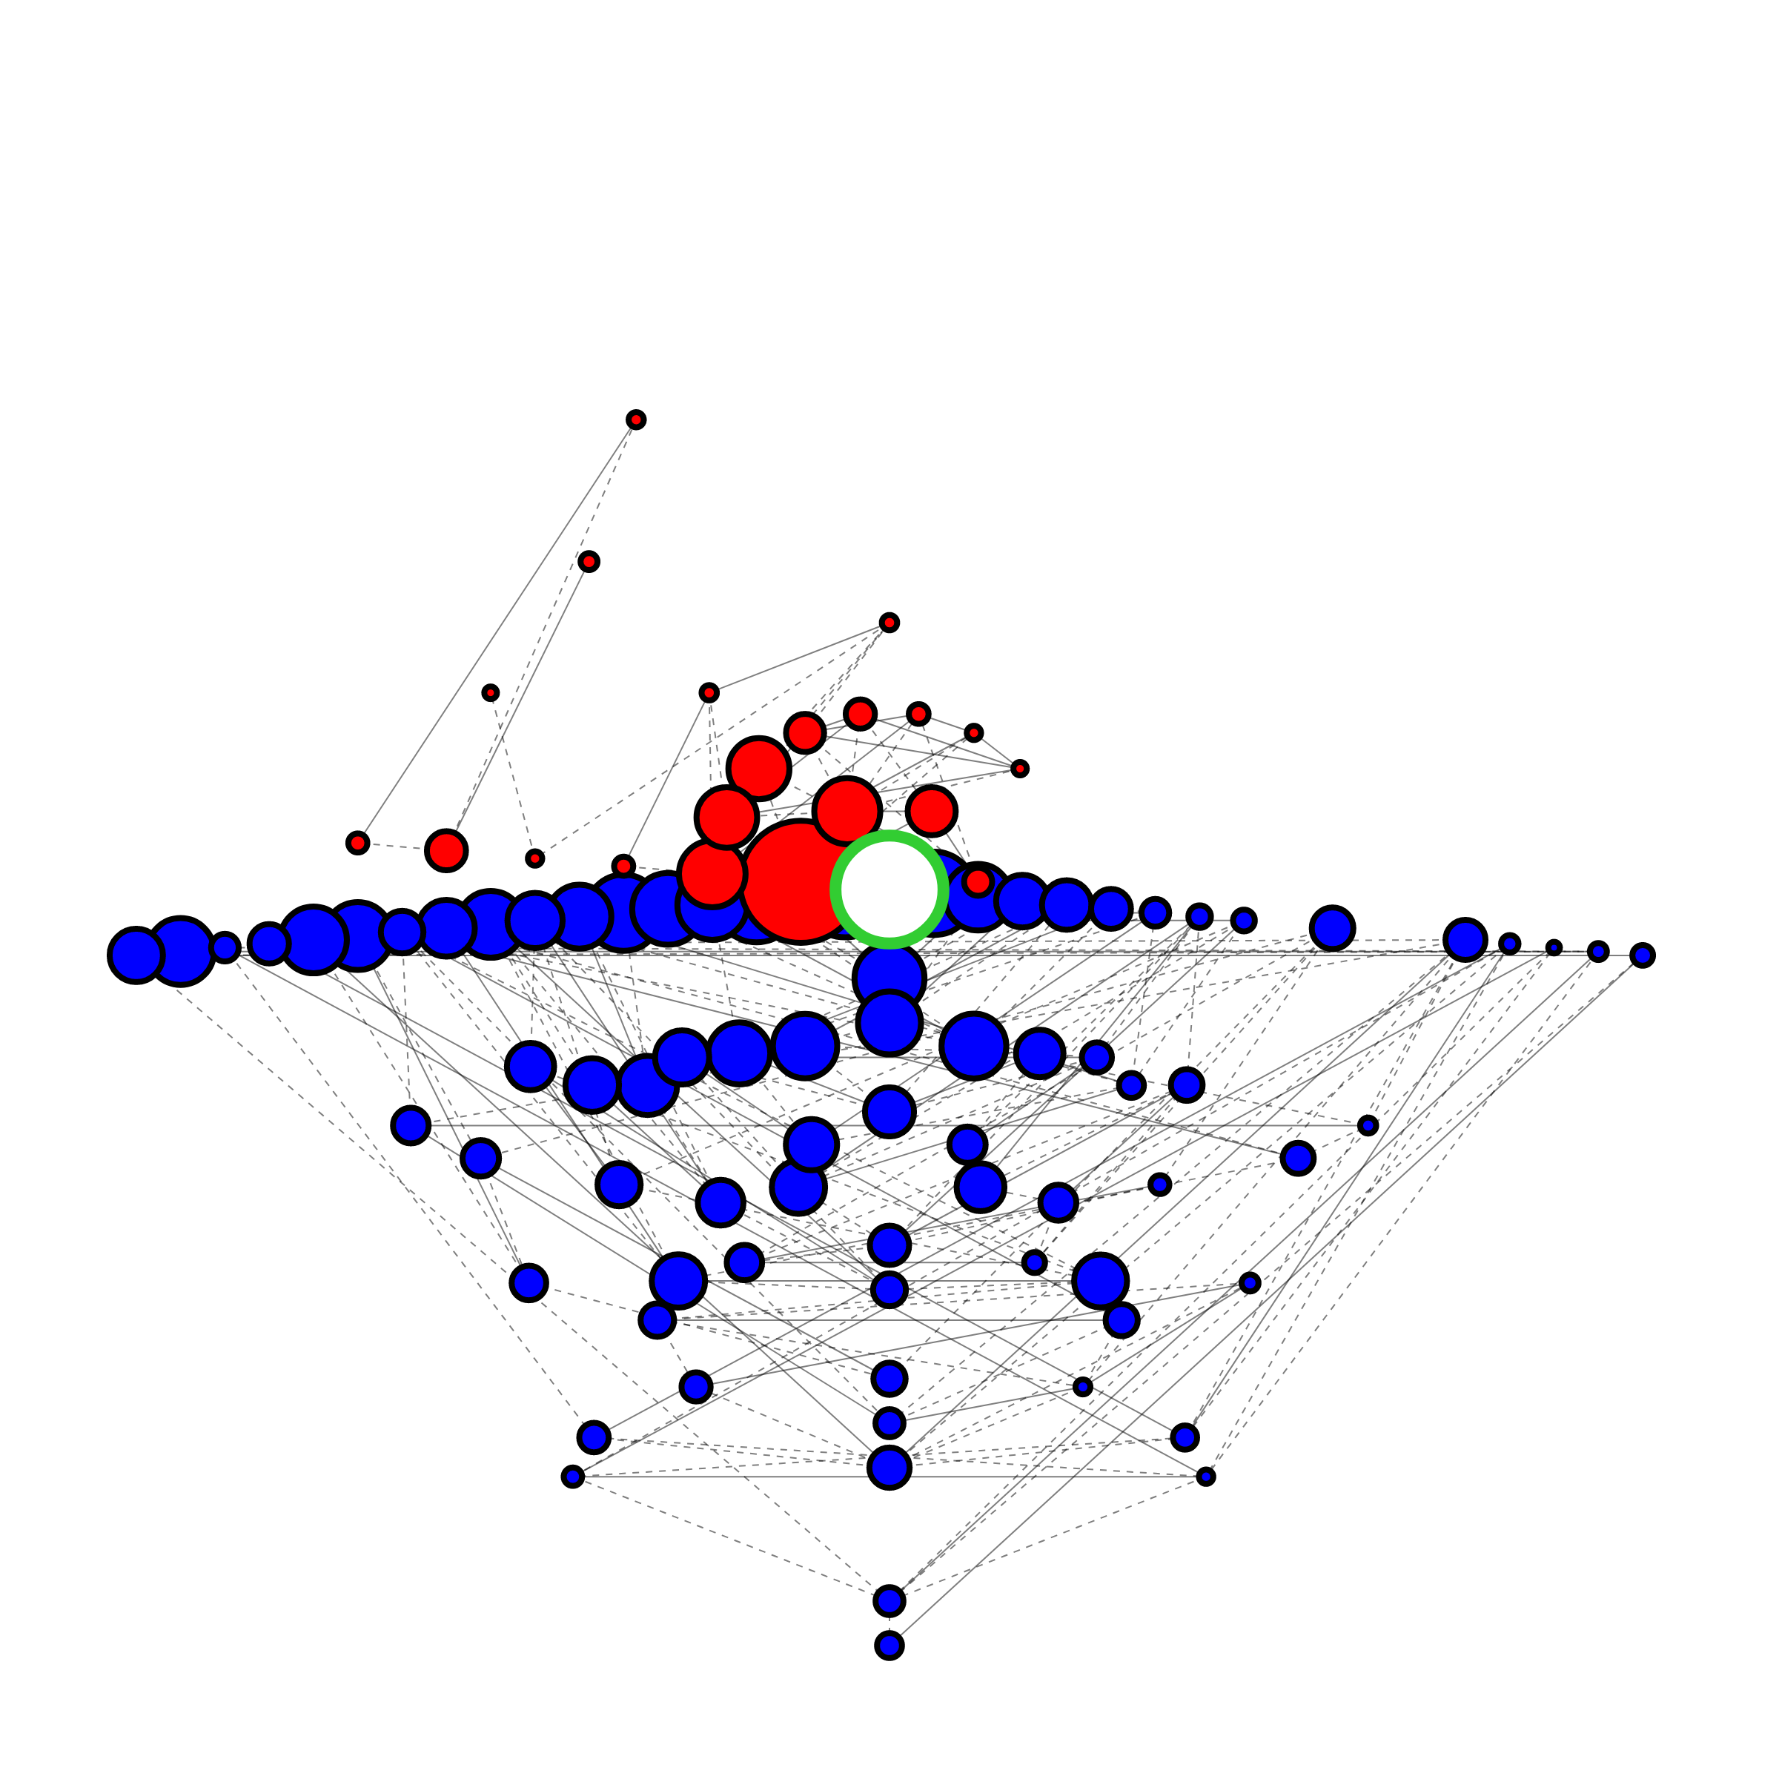
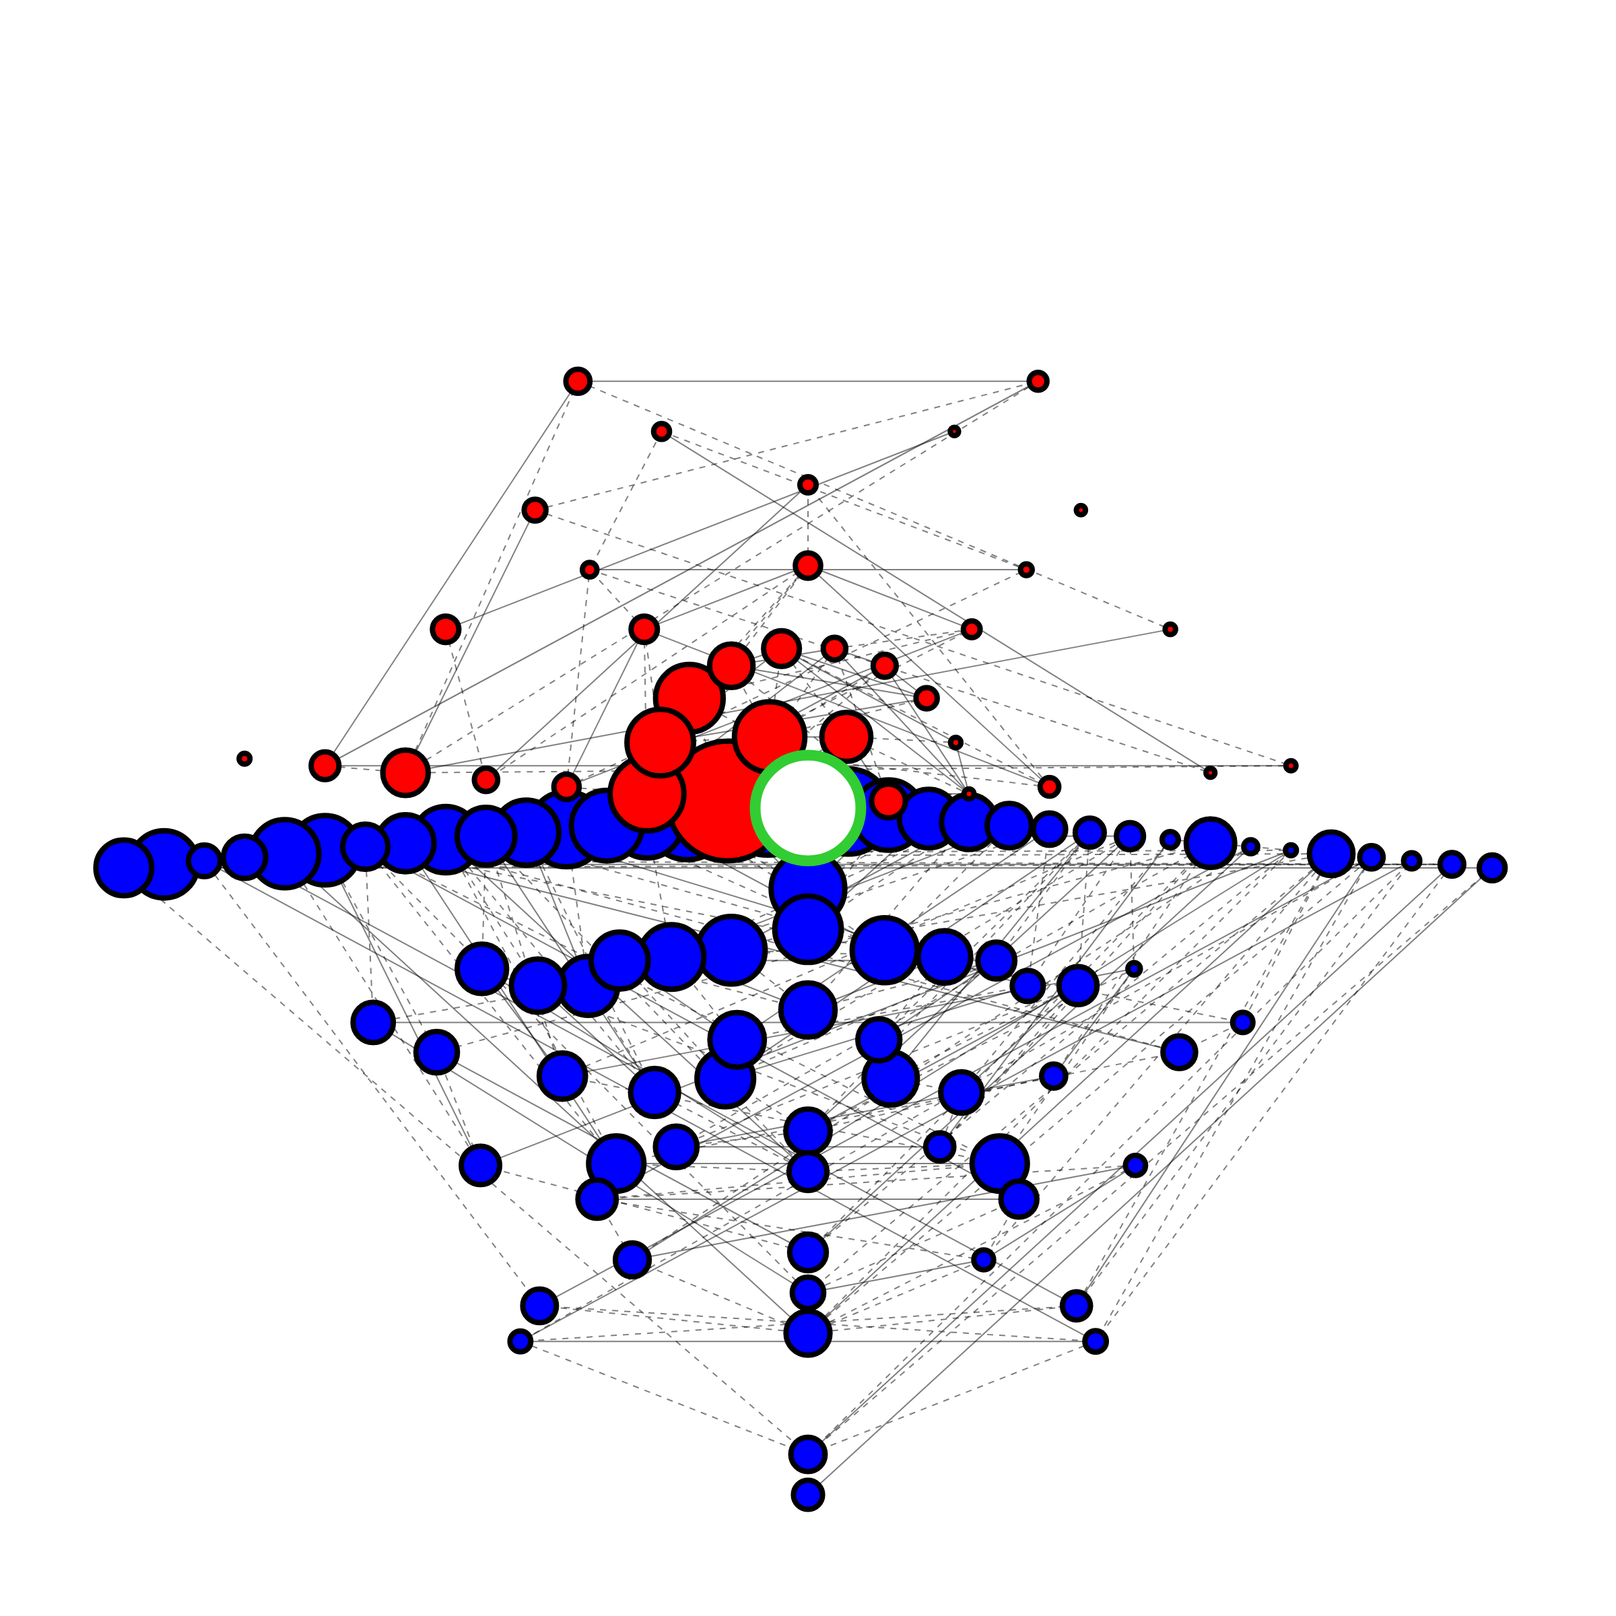
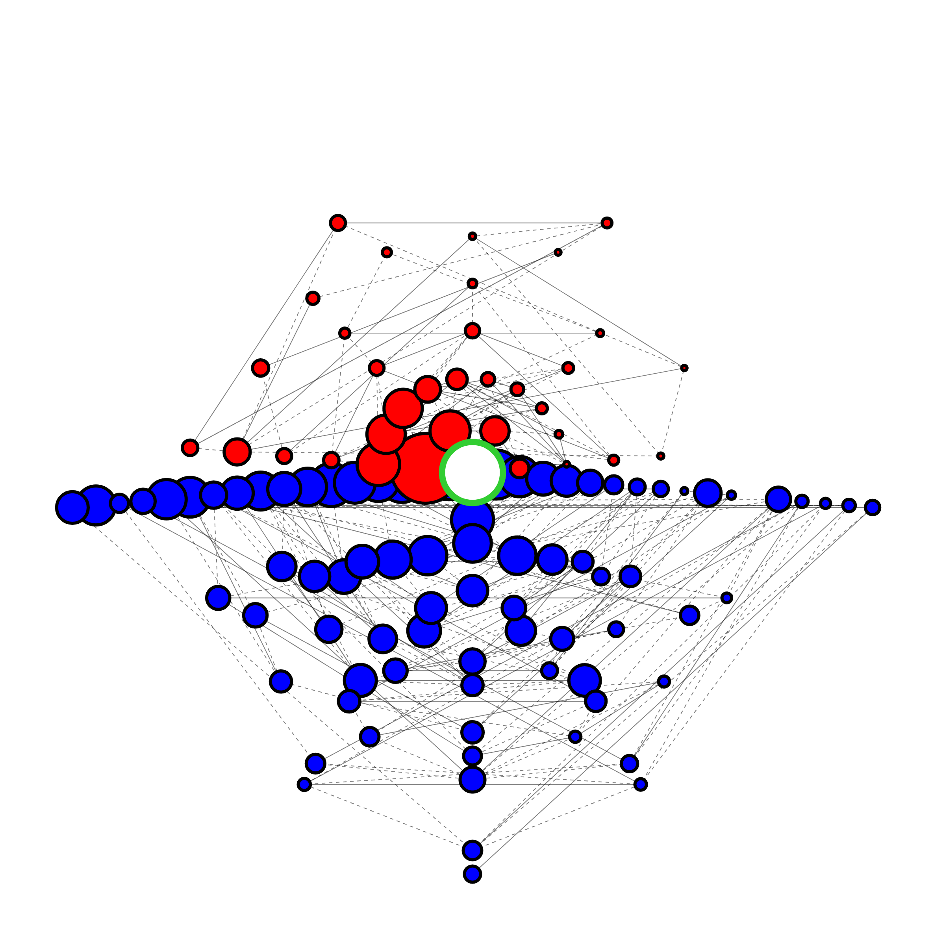
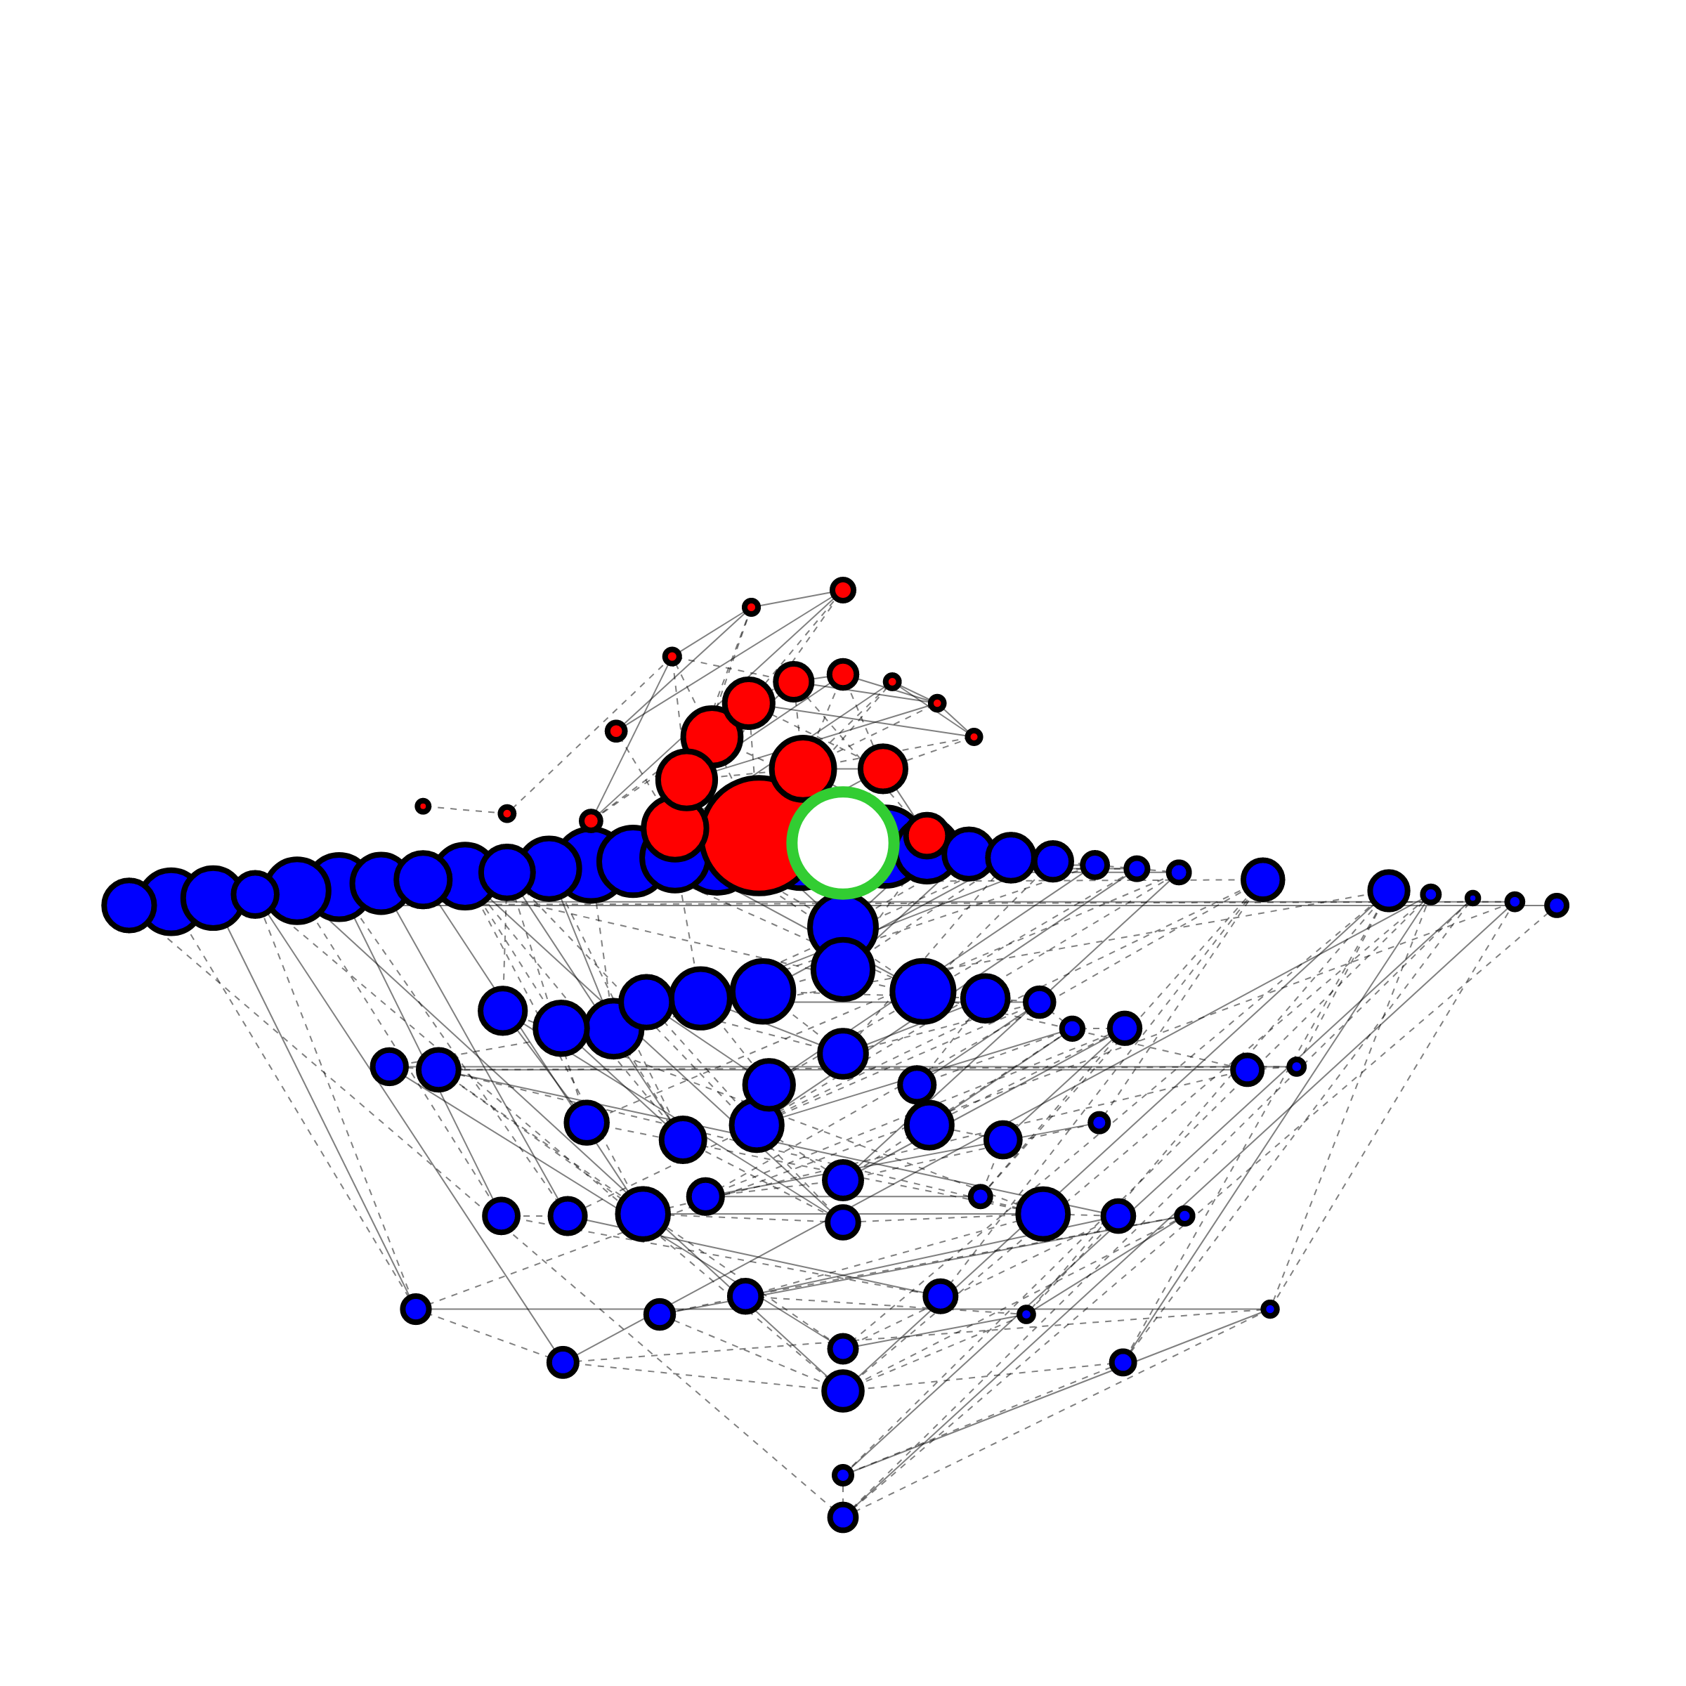
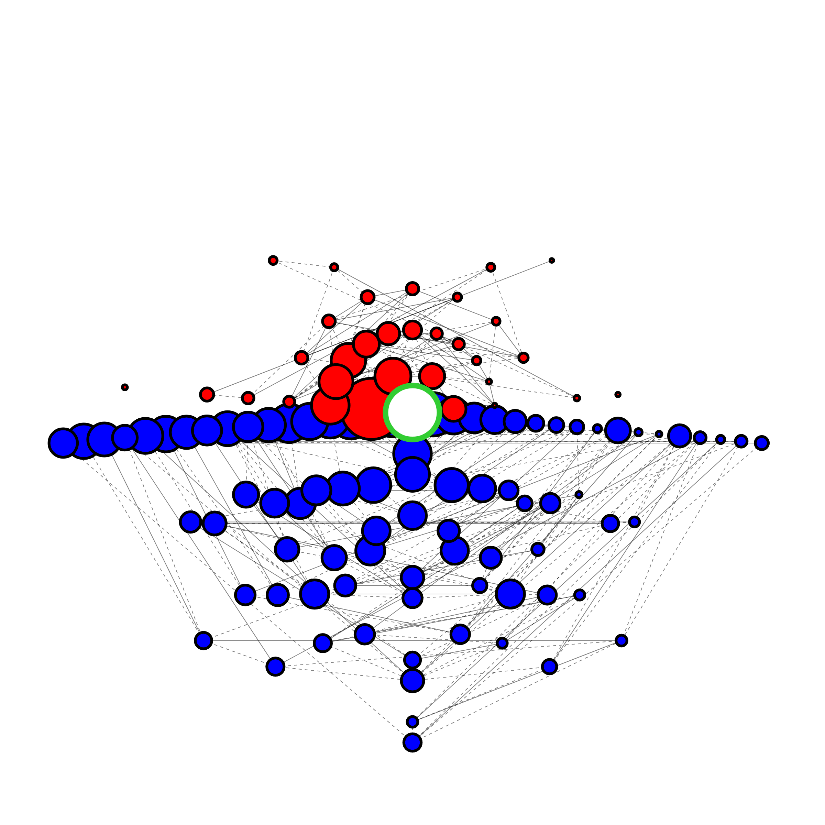

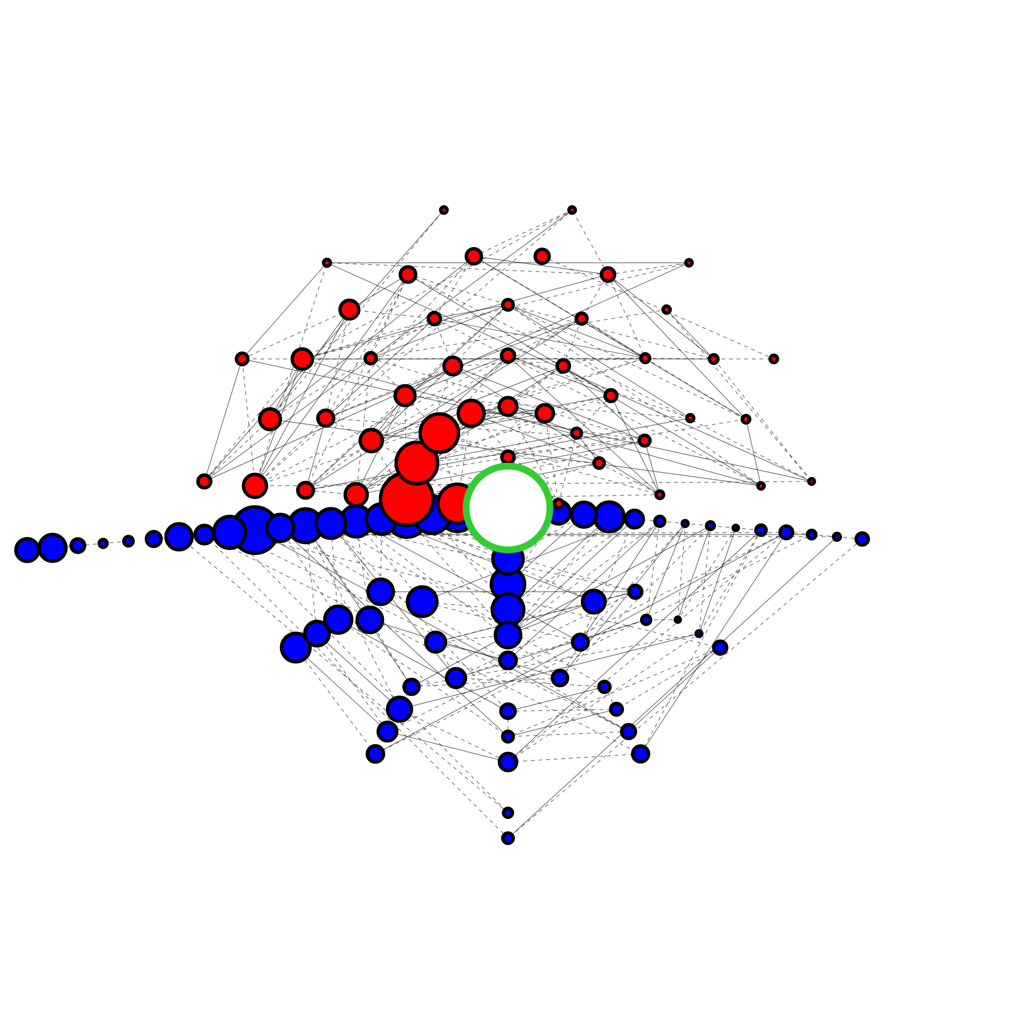
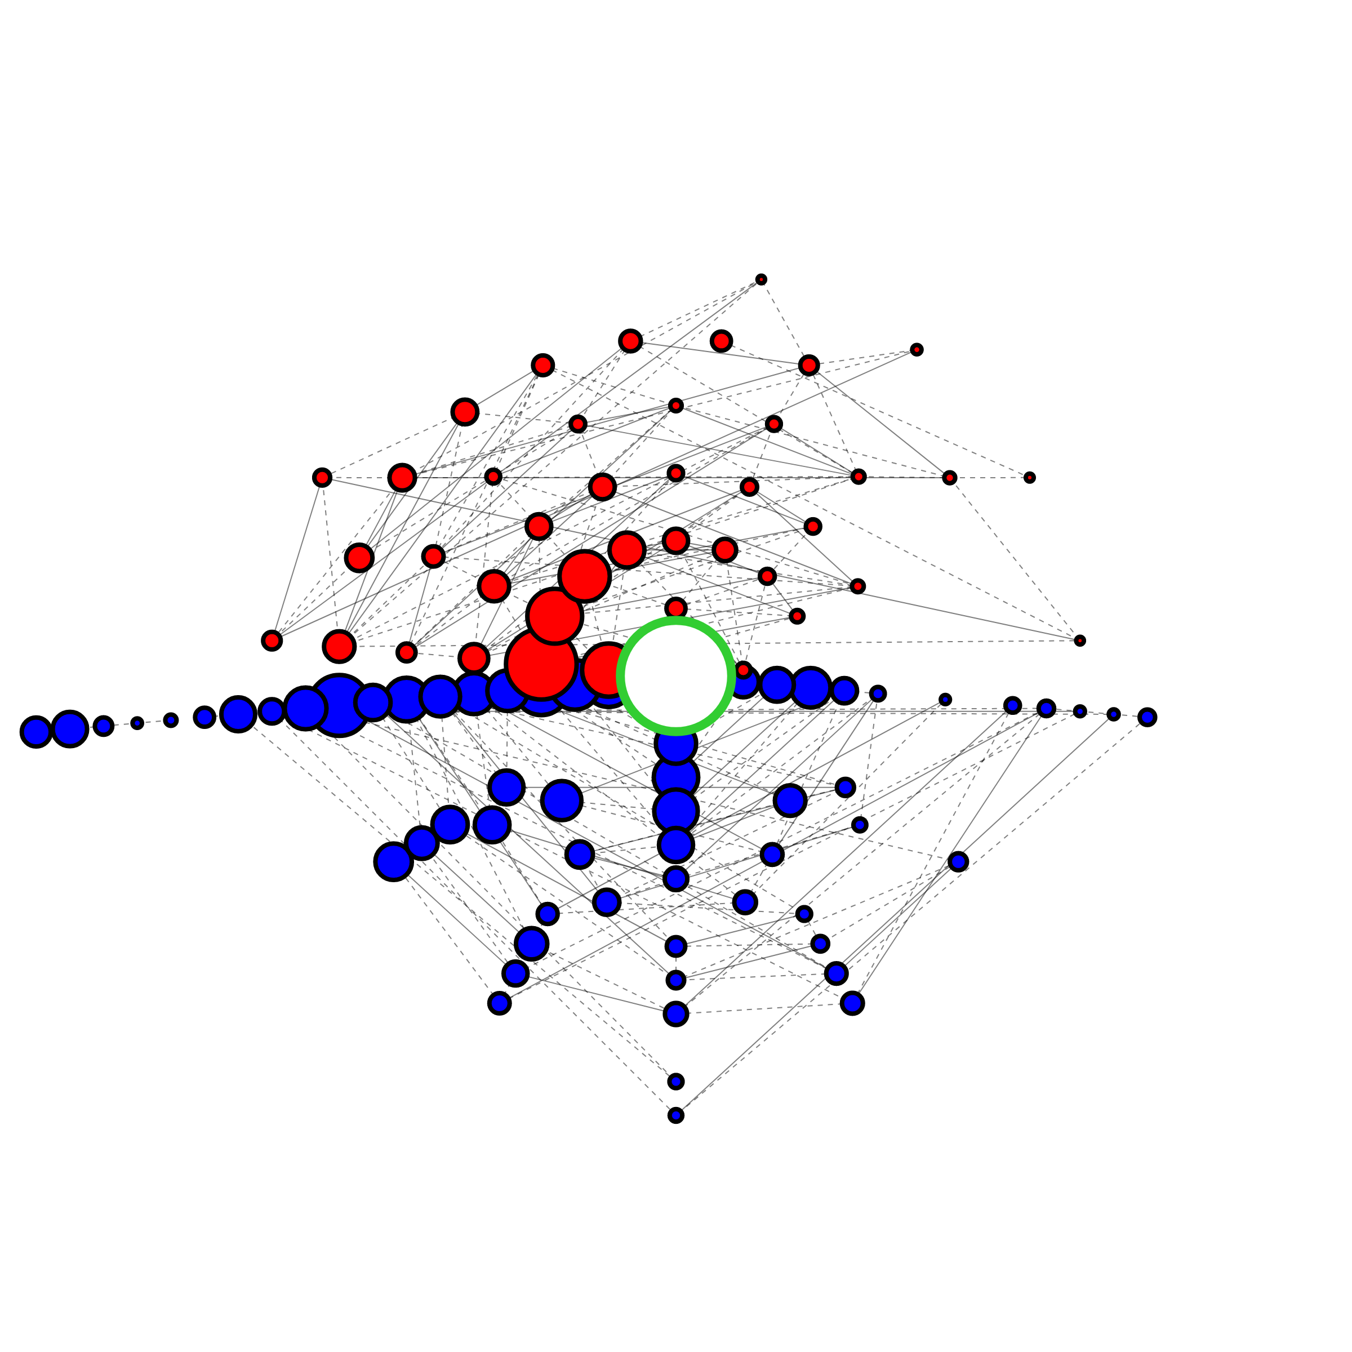
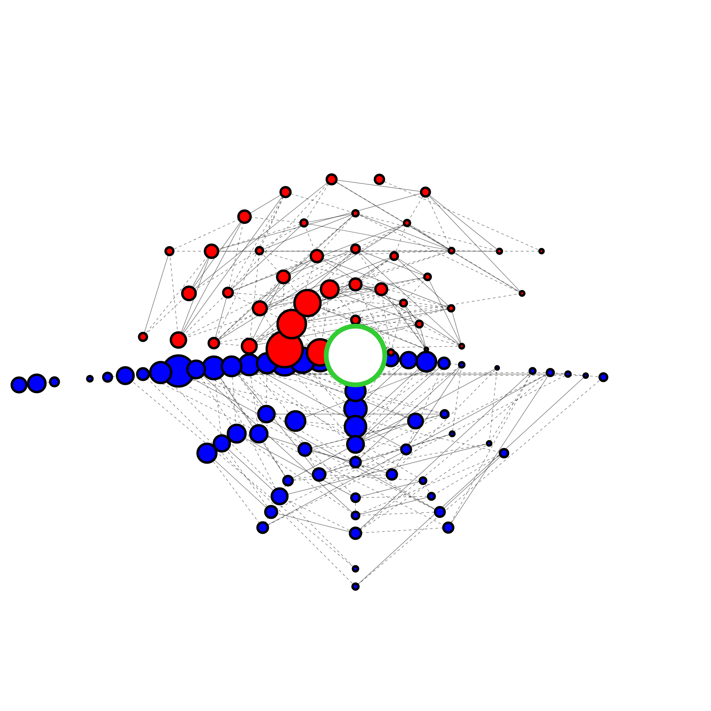
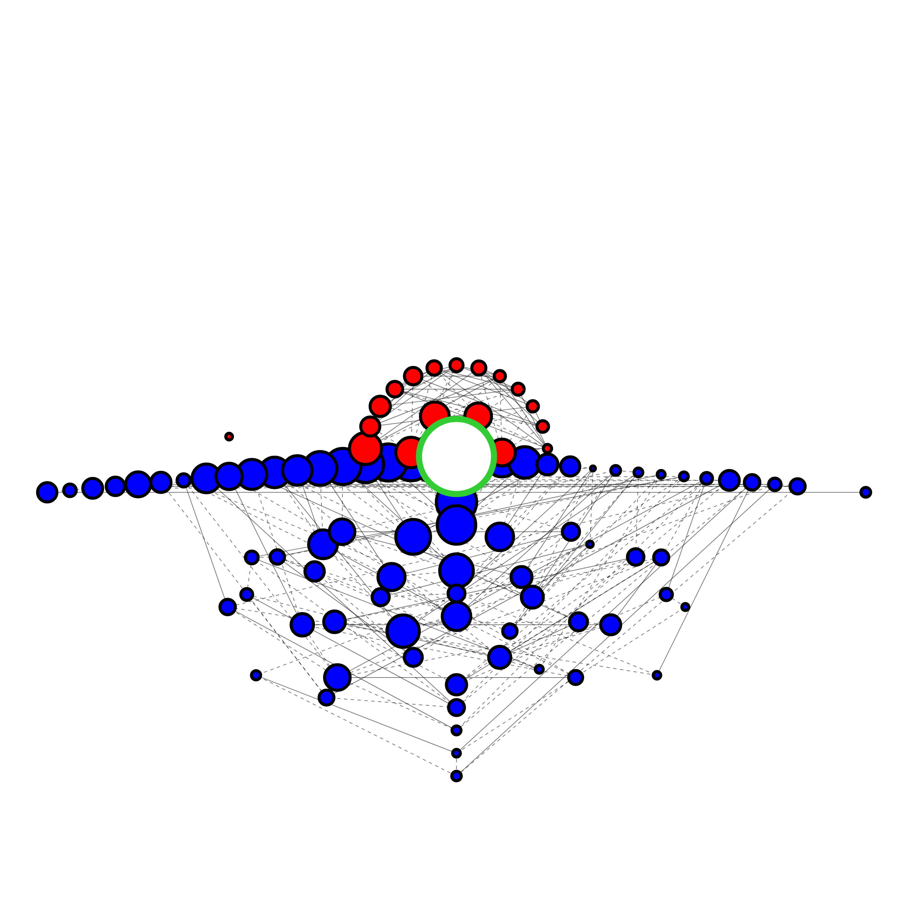
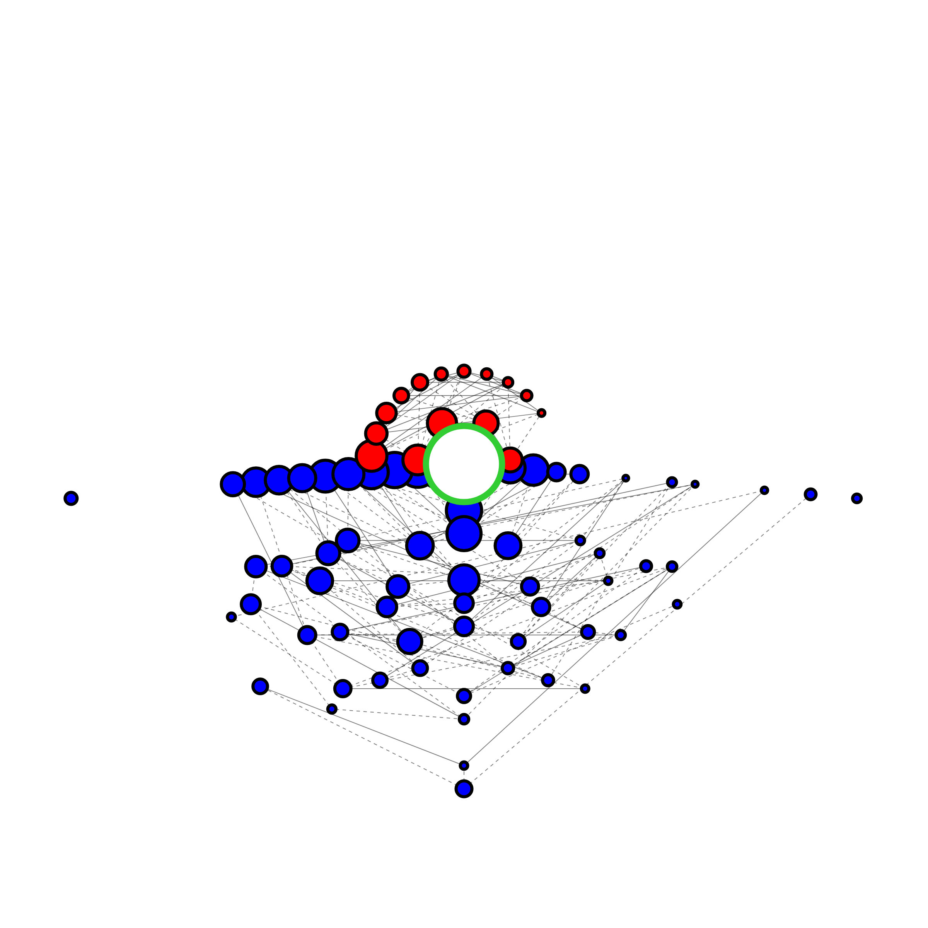
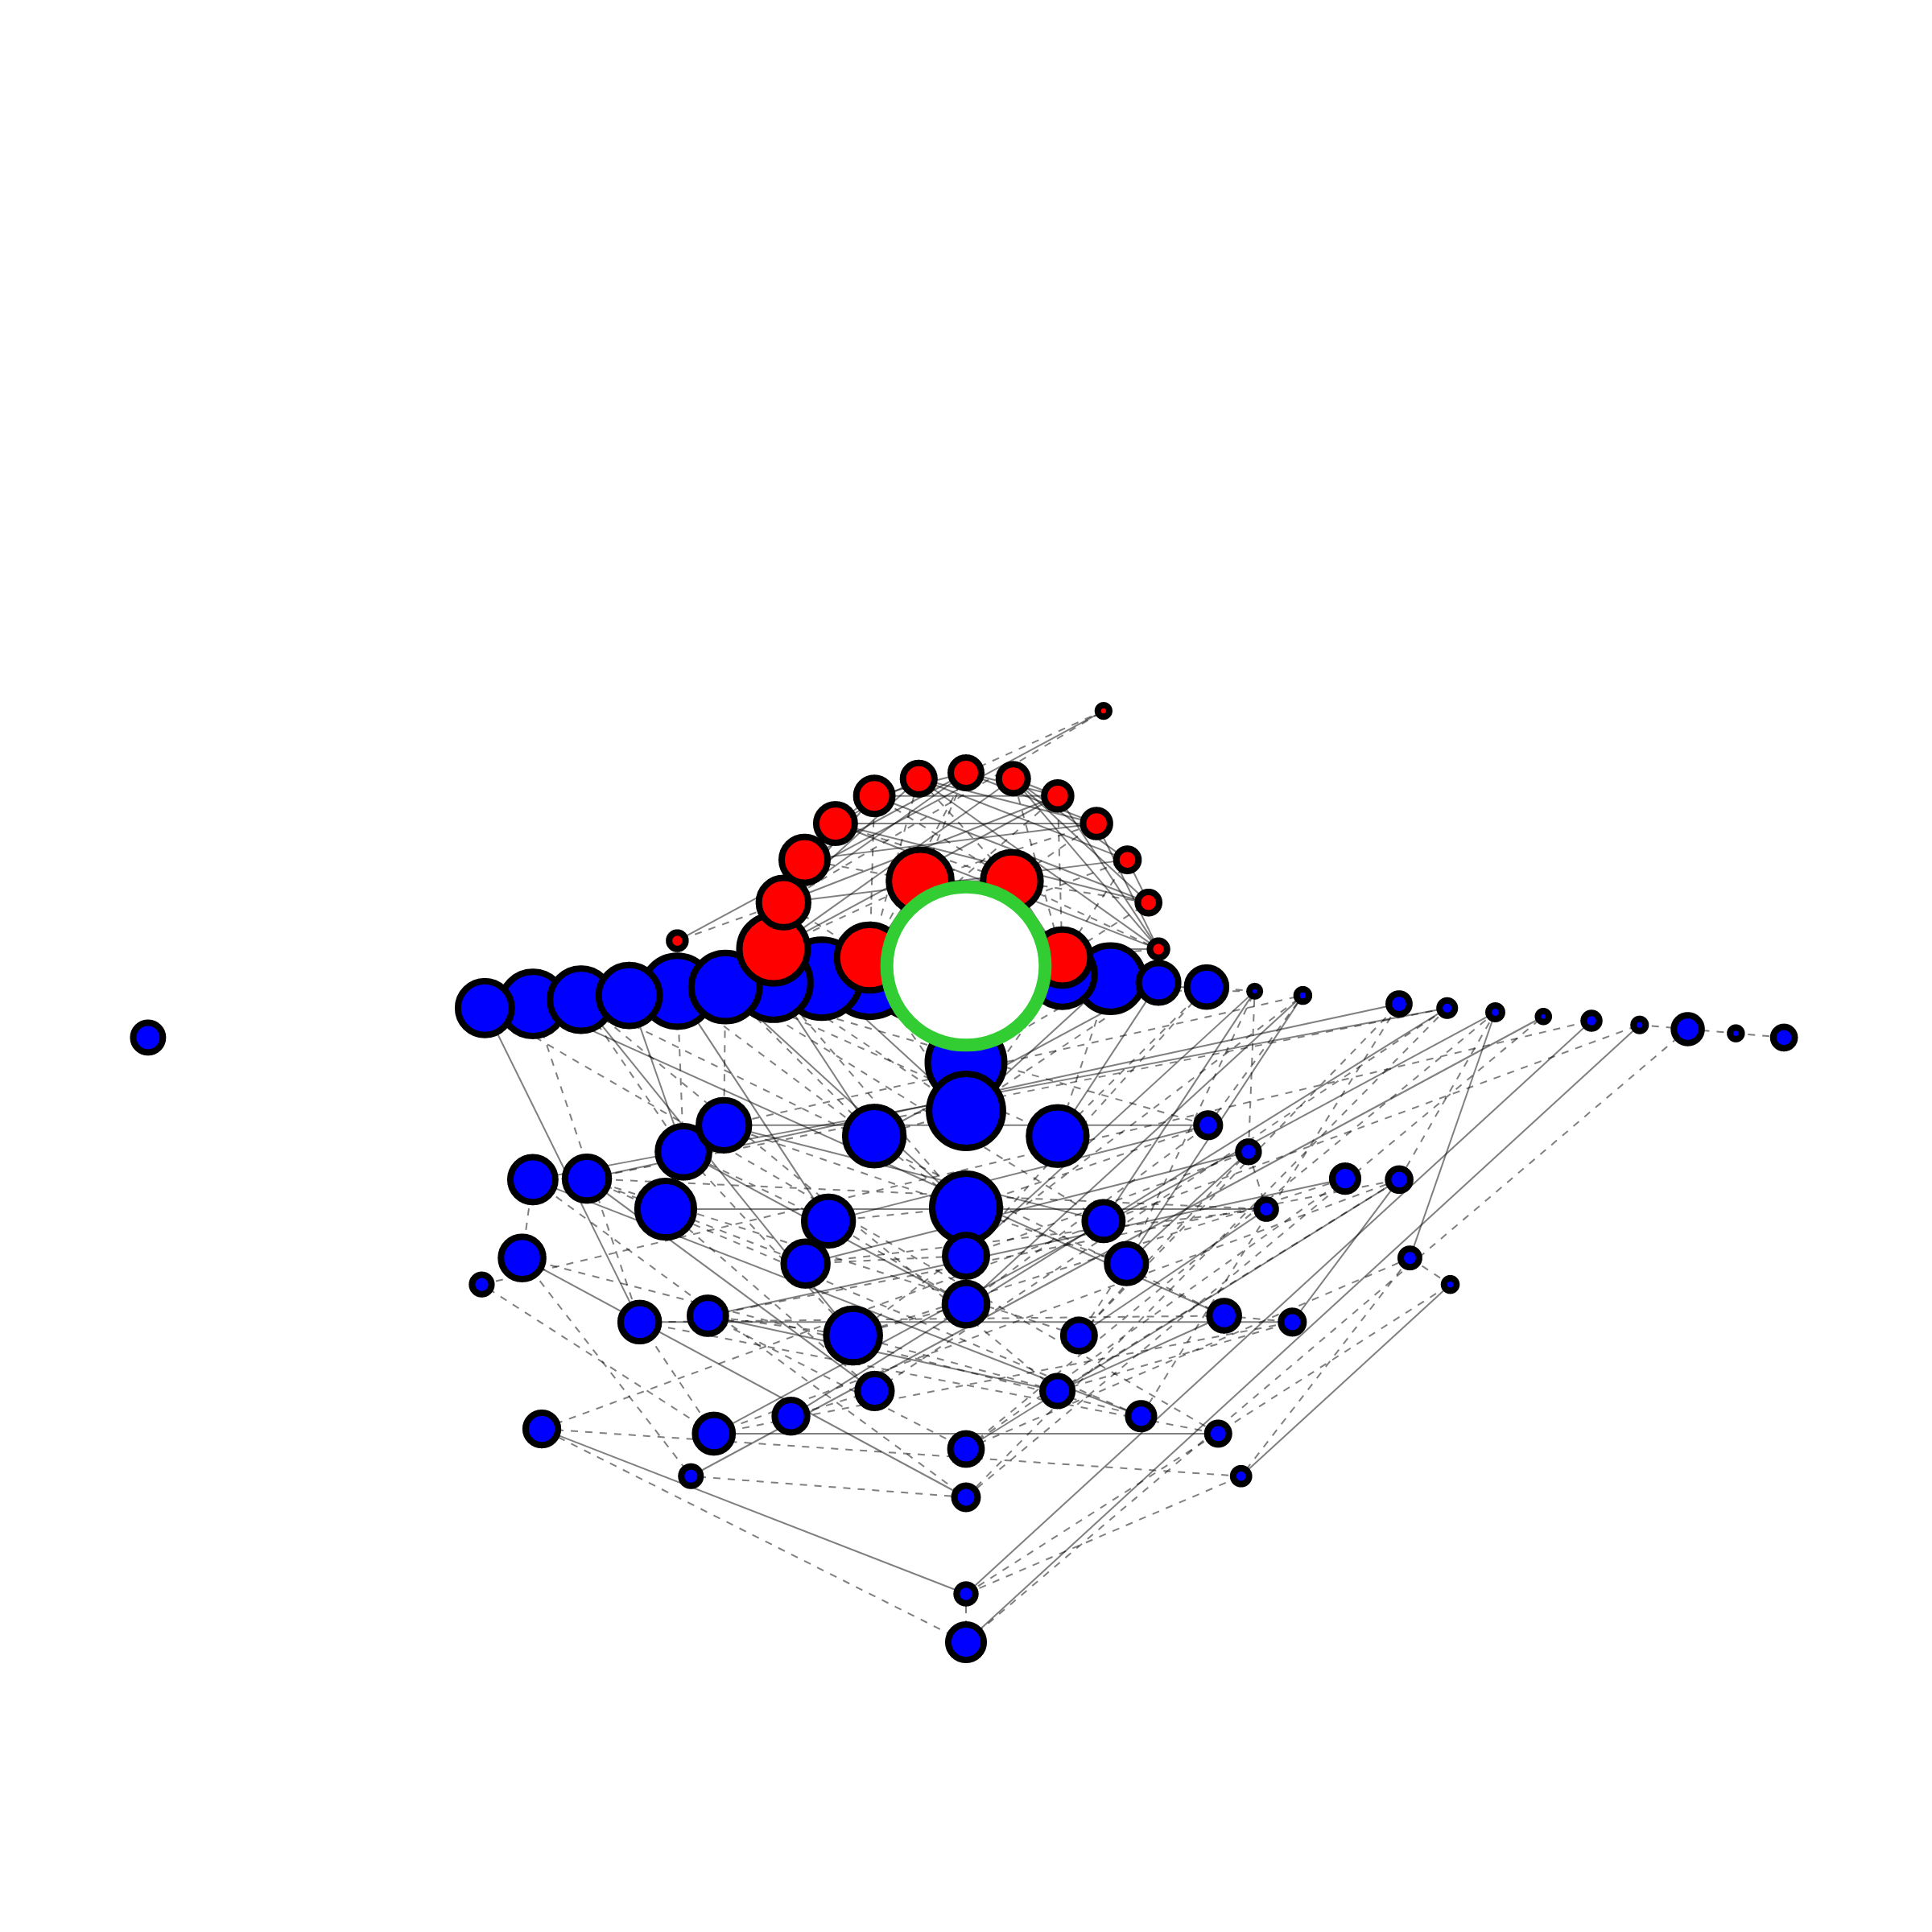
WT_sgAB_R1_branch
WT_sgAB_R1_cmv
WT_sgAB_R1_sense
Frequency Size Scale
Frequency Size Scale
≥1
10⁻¹
≥1
10⁻¹
10⁻²
10⁻³
10⁻⁴
≤10⁻⁵
10⁻²
10⁻³
10⁻⁴
≤10⁻⁵
Variation Types
Variation Types
Insertion
Deletion
Insertion
Deletion
None
WT_sgAB_R2_branch
WT_sgAB_R2_cmv
WT_sgAB_R2_sense
None
WT_sgA_R1_branch
WT_sgA_R1_cmv
WT_sgA_R1_sense
WT_sgB_R2_branch
WT_sgB_R2_cmv
WT_sgB_R2_sense

